Slide 1
Can We Do This in Online Teaching?
YongJei Lee, Ph. D.
School of Public Affairs
University of Colorado Colorado Springs
Presentation prepared for the GIFT (Great Ideas for Teaching) Exchange

Slide 2
Agenda
Background Music (BGM)
UCCS Remote Desktop (Open Lab Desktop)
Software in Remote Desktop

Slide 3
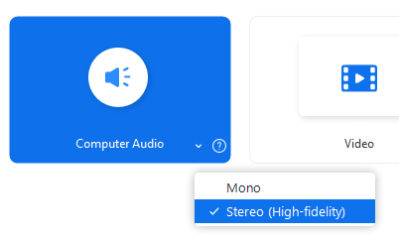
BGM

Slide 4
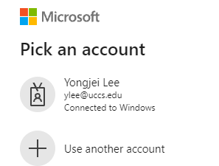
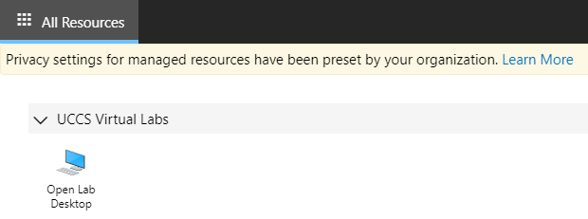
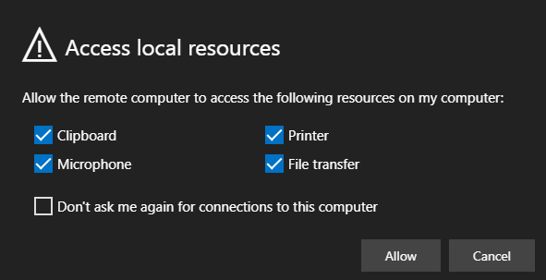
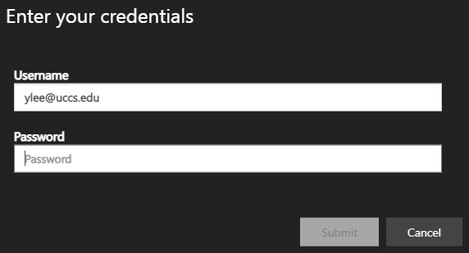
UCCS Remote Desktop
https://desktopfinder.uccs.edu/

Slide 5
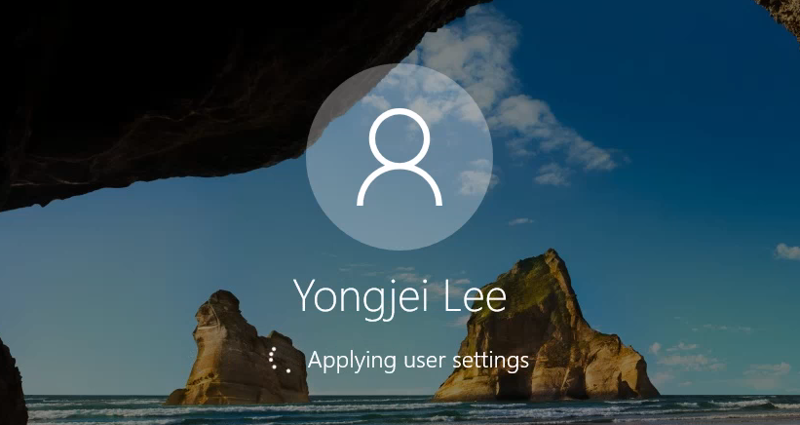
UCCS Remote Desktop (cont’d)
Let’s try to connect
UCCS Remote Desktop!
https://desktopfinder.uccs.edu/

Slide 6
Software in Remote Desktop
Adobe Series
ArcMap or ArcPro
SPSS + Amos
Tableau
Other software on demand (https://oit.uccs.edu/services/smart-classrooms-open-labs/complabsoftware)

Slide 7
Thank You
YongJei Lee
ylee@uccs.edu

