Slide 1
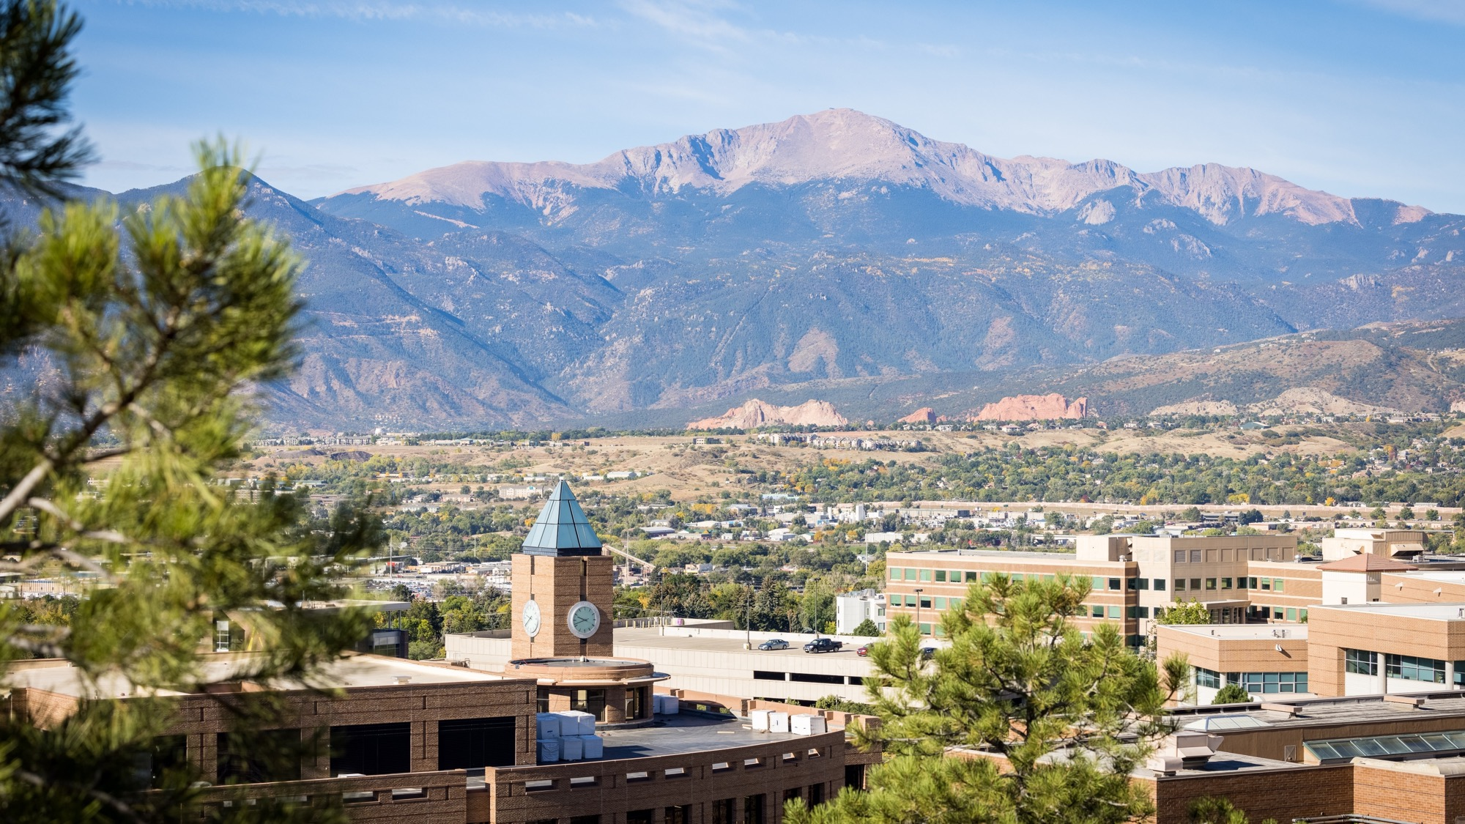
Connecting Students with Faculty and Campus: Strategies for Student Success
Ann Amicucci, Director of First-Year Rhetoric and Writing: aamicucc@uccs.edu

Slide 2
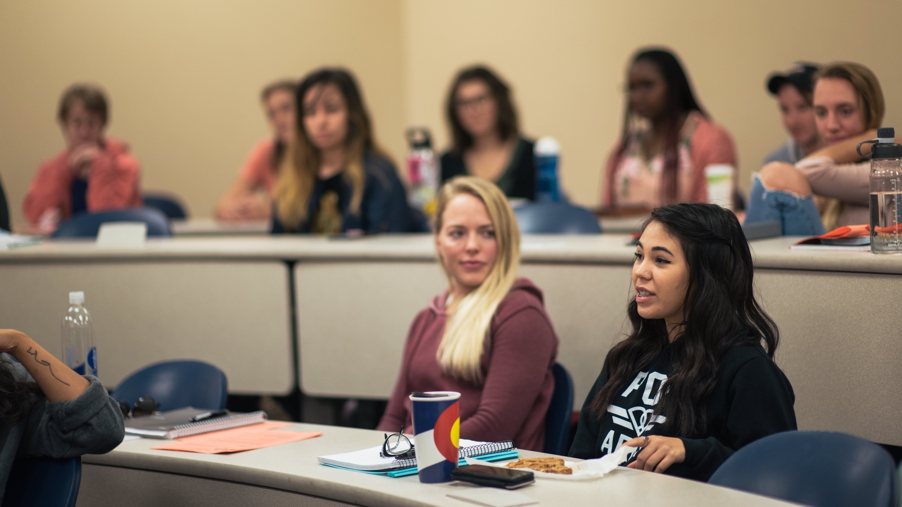
A teaching story

Slide 3
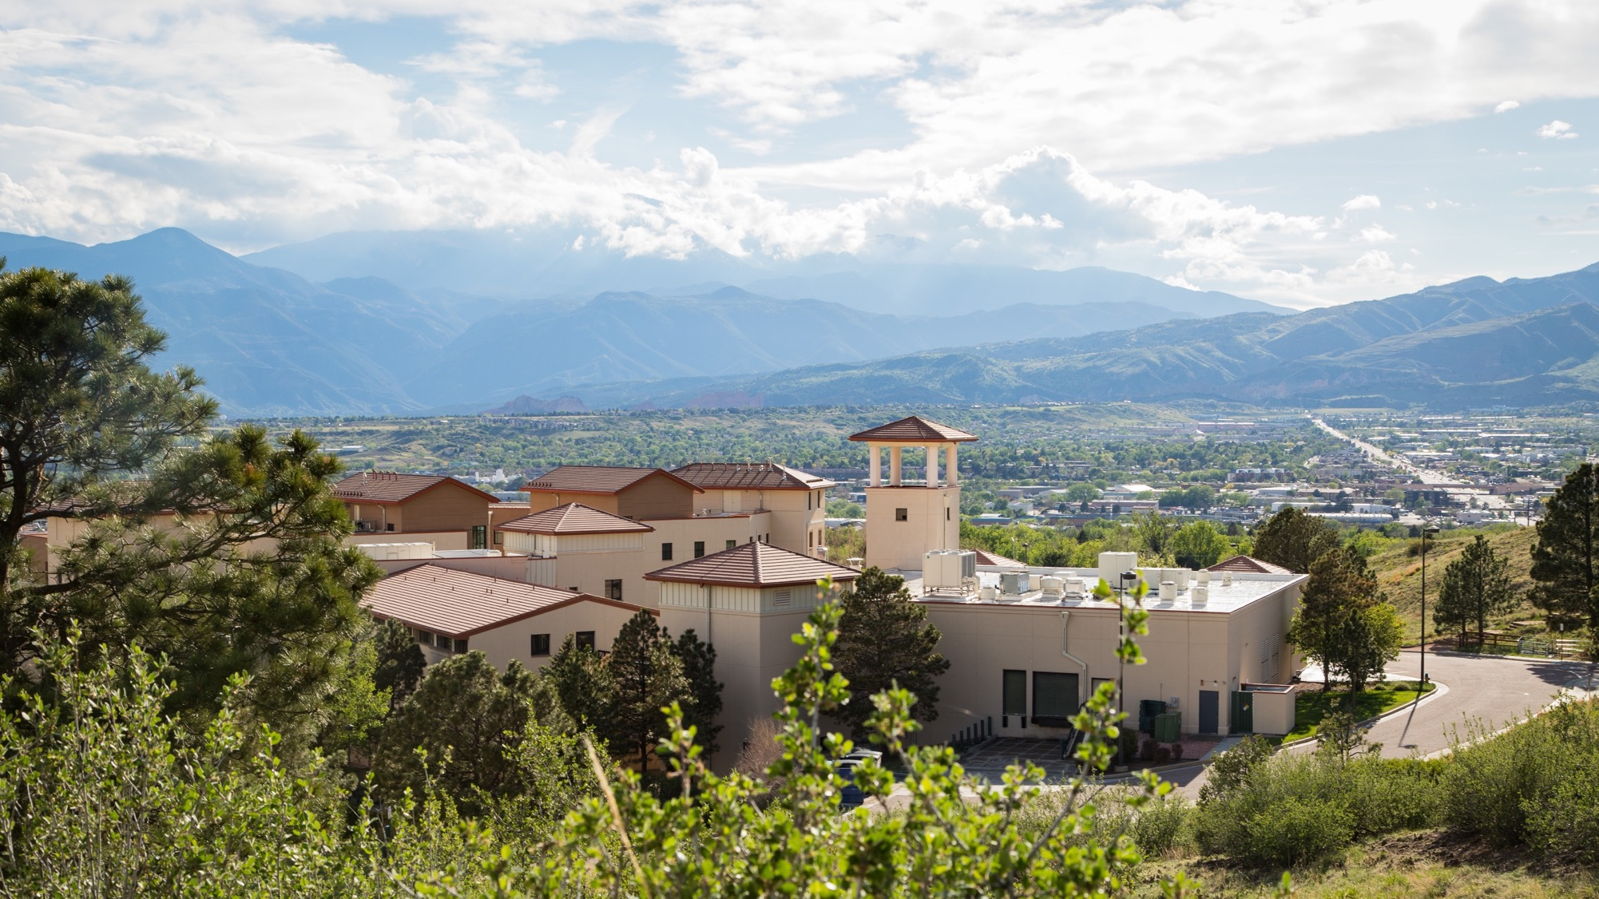
Hi Katrina,
I’m writing to touch base since I know today’s class conversation about African American Language was a challenging one. I got the sense from your and a few other students’ body language that this was a draining conversation. I imagine it must be challenging – perhaps exhausting is a better word – to be a woman of color in such conversations and be in the position of having to explain privilege to people with white privilege. I certainly can’t know what your experience is like, but I want you to know I recognize that conversations like today’s must be taxing.
Please know that I do not expect you to respond to this email. Please do not feel obligated to respond. However, if you’d like to chat this week (or at any point) about today’s class discussion, let me know.
I hope the rest of your week goes well.
-Dr. Amicucci

Slide 4
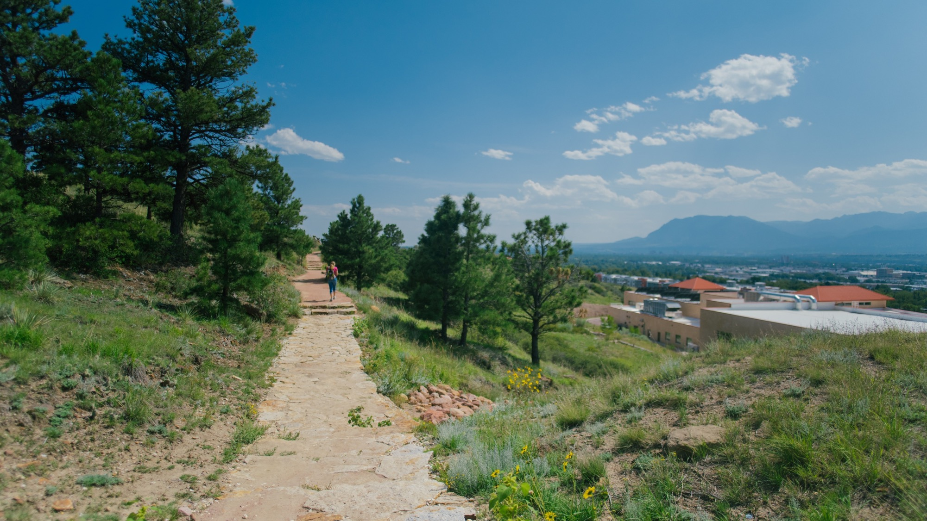
What does this story make you think of as a teacher?
Share aloud or in the chat.

Slide 5
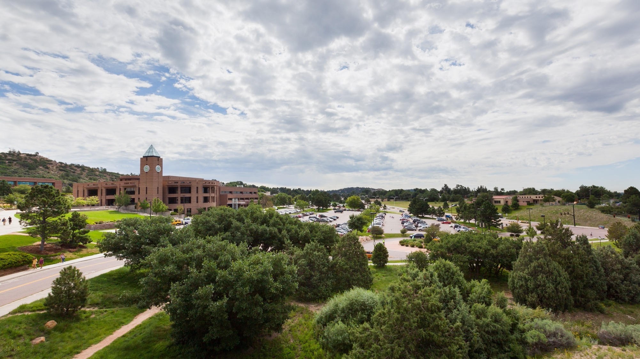
Relationships and connections matter
Relationships with faculty predict students’ academic success (Burke, 2019; Koproske et al., 2018; Umbach & Wawrzynski, 2005)

Slide 6
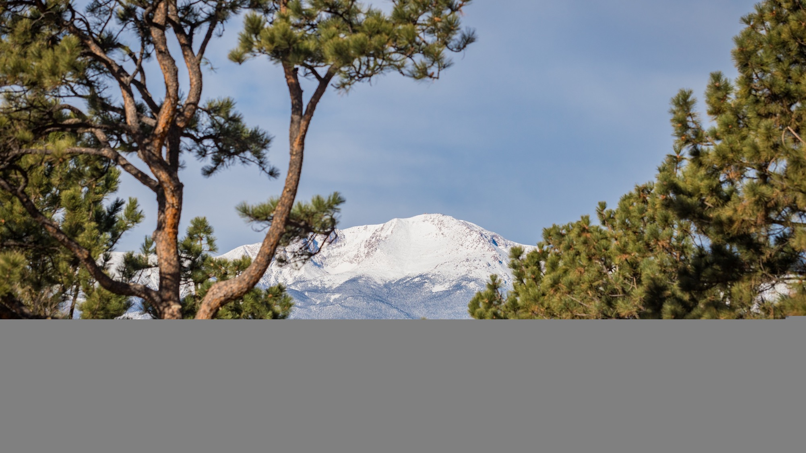
Overall retention, 2020 to 2021: 65% (Institutional Research, 2021)
In a club: 77%
Attended 1 event: 72%
4 or more events: 80%
Felt valued: 89%
Felt part of a community: 90%

Slide 7
We want students to feel a sense of belonging (Venit & Bevevino, 2020)

Slide 8
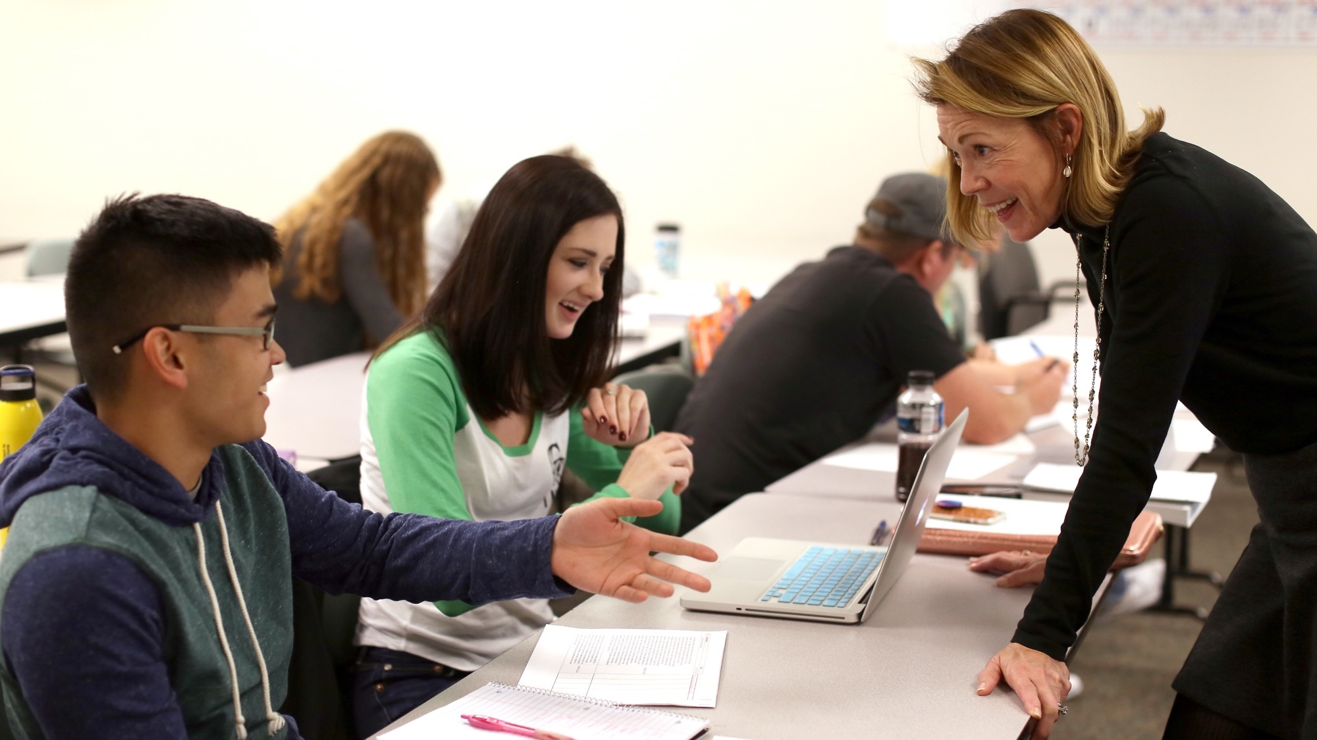
Building relationships with students

Slide 9
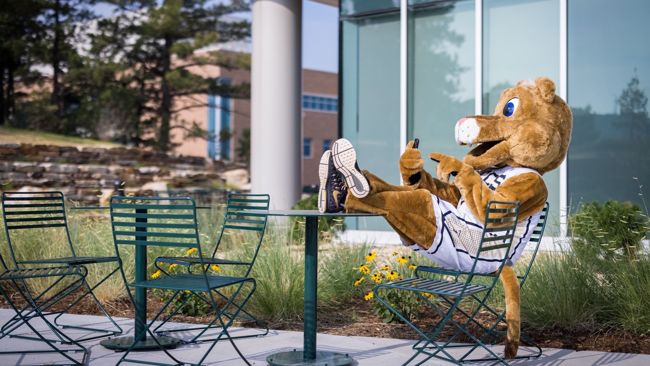
Set a welcoming tone
Syllabi:
1st and 2nd person
Communication expectations
Avoid jargon
Explain policy reasons

Slide 10
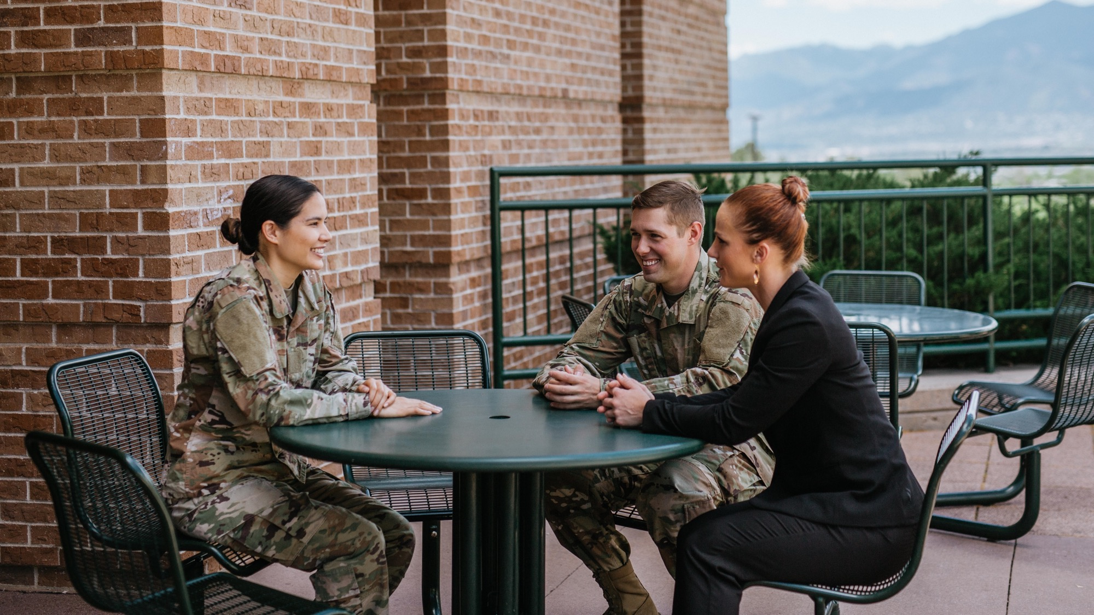
Making personal connections
Ask for names, pronouns (Lightner, 2017)
Give preferred title
Share some personal details

Slide 11
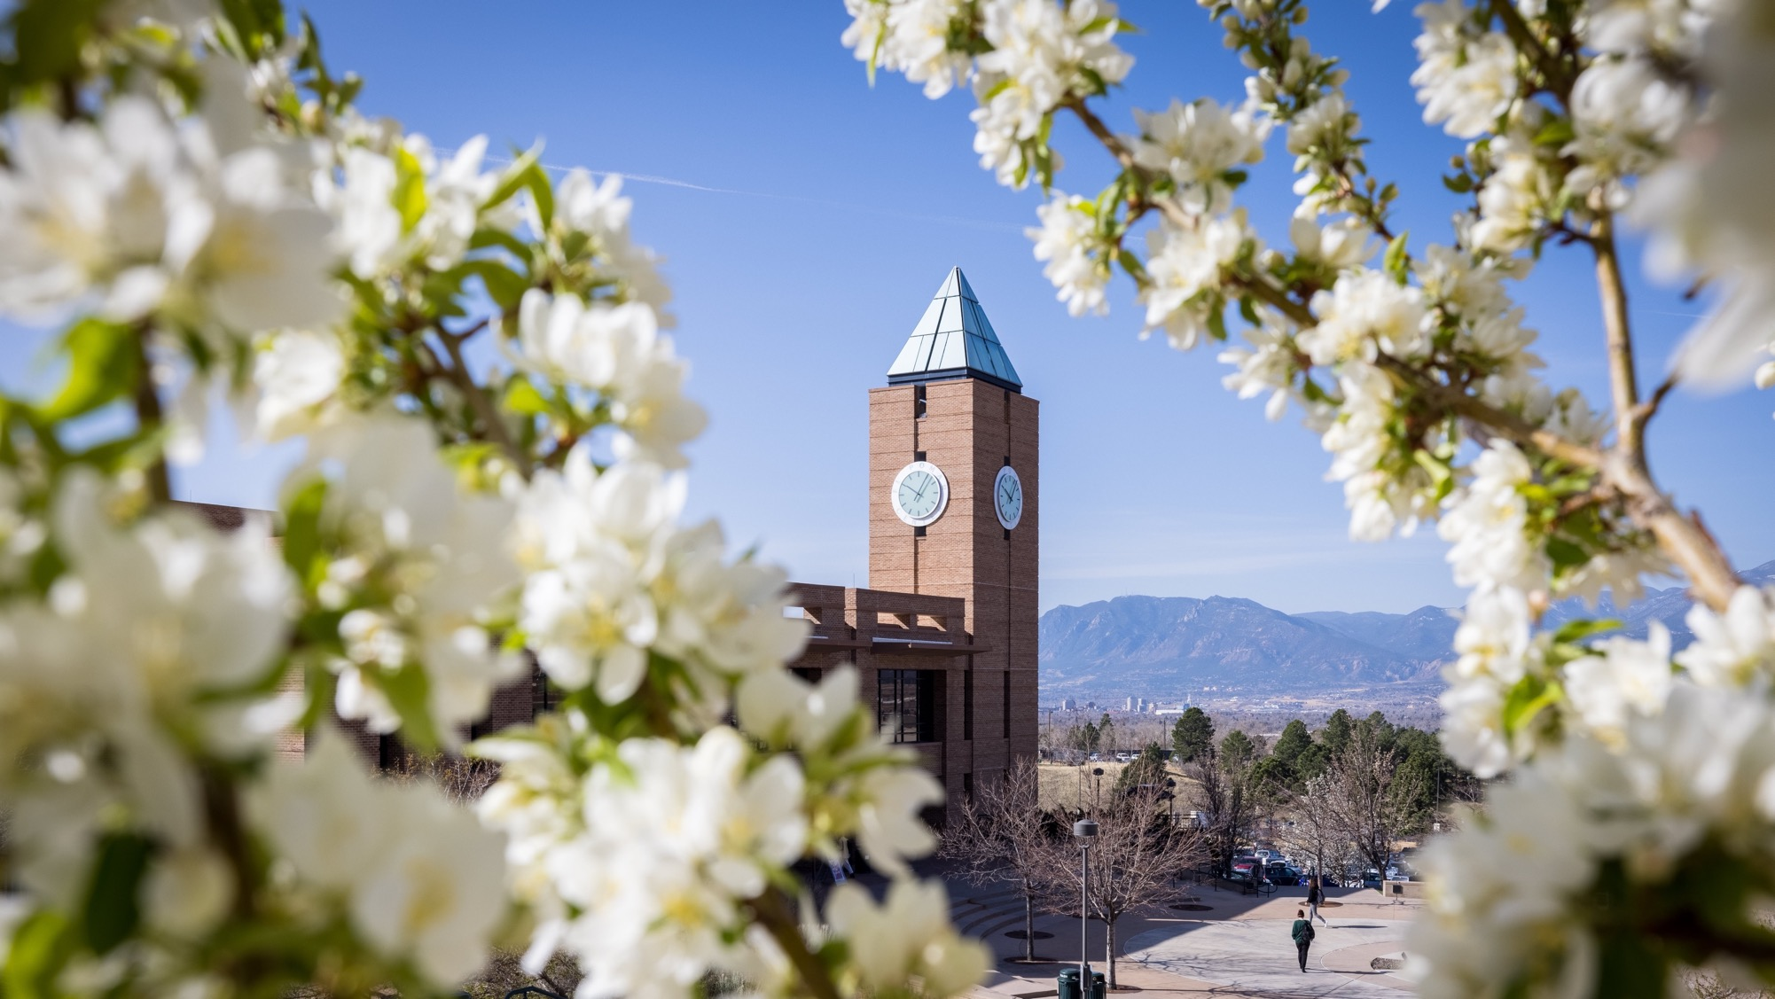
Which of these strategies feel like they come naturally?
Which feel harder for you?

Slide 12
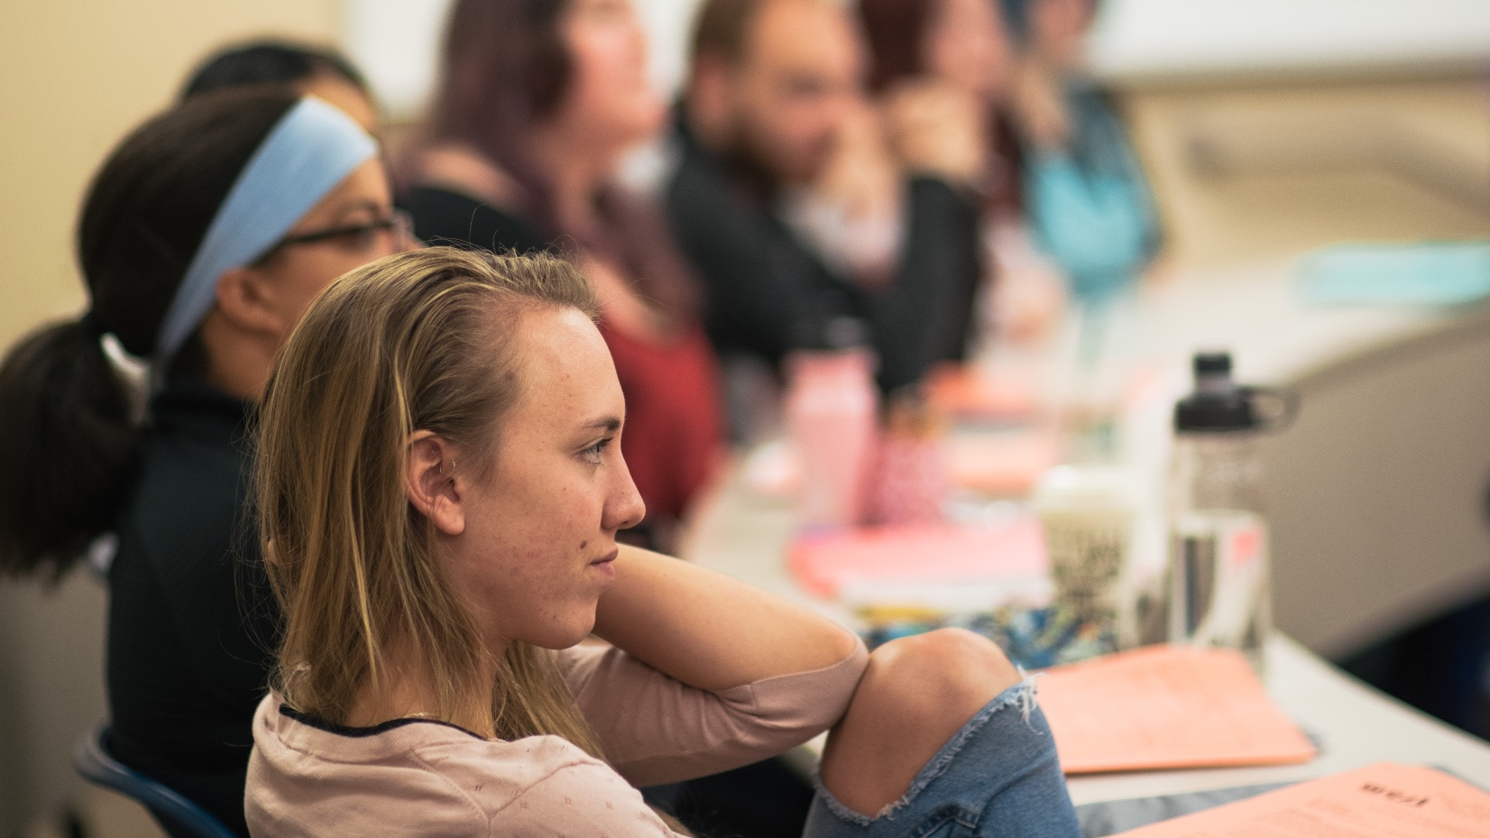
A teaching story, continued

Slide 13
Checking in
Hi Kevin,
I’m reaching out because you haven’t been in class lately, and I’m concerned about what’s going on. Is everything okay?
-Dr. Amicucci

Slide 14
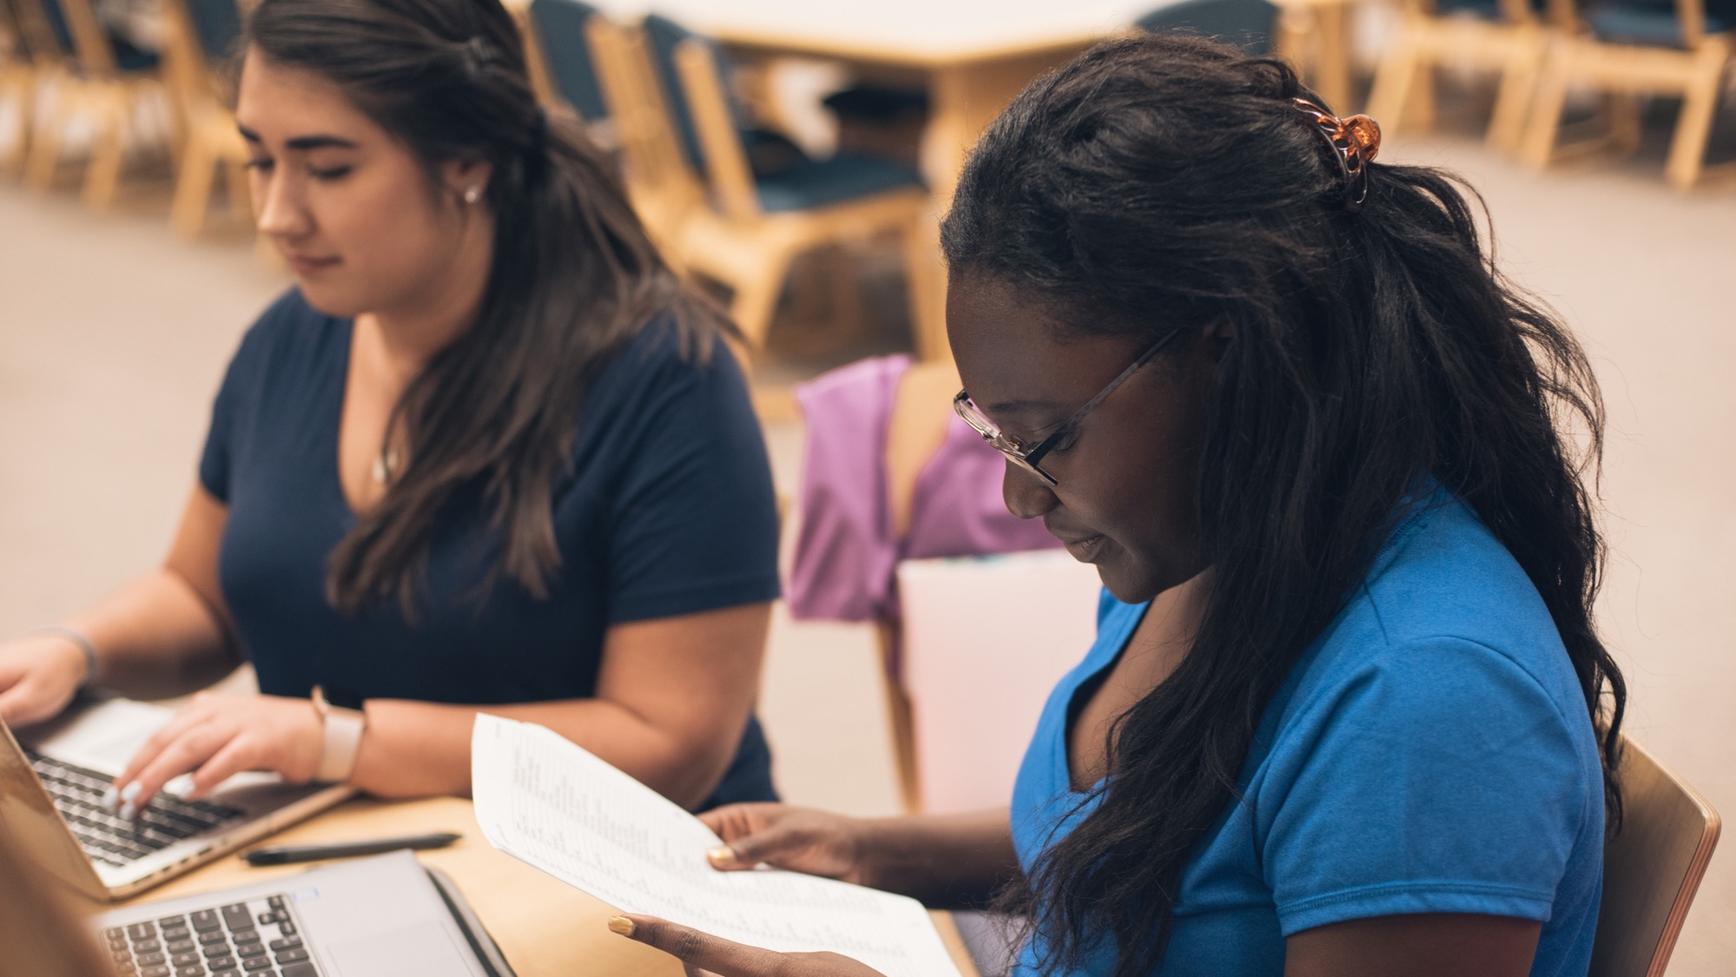
Office hour questions:
What classes are you taking? How are they going?
Who are you living with?
Do you have a job?

Slide 15
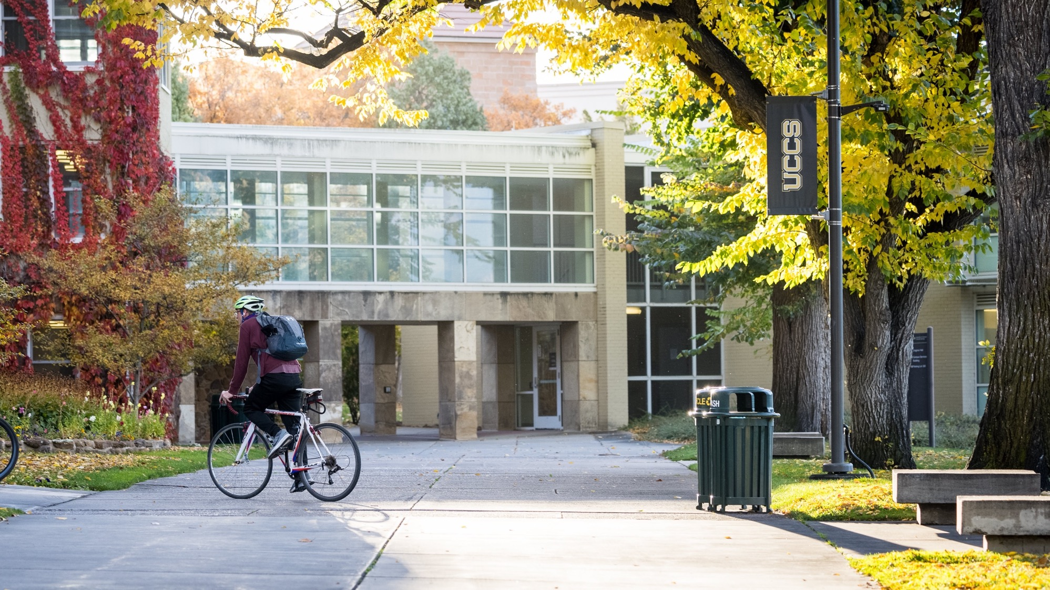
Check course policies (Venit & Bevevino, 2020)
Eliminate barriers to success
Focus on relationships

Slide 16
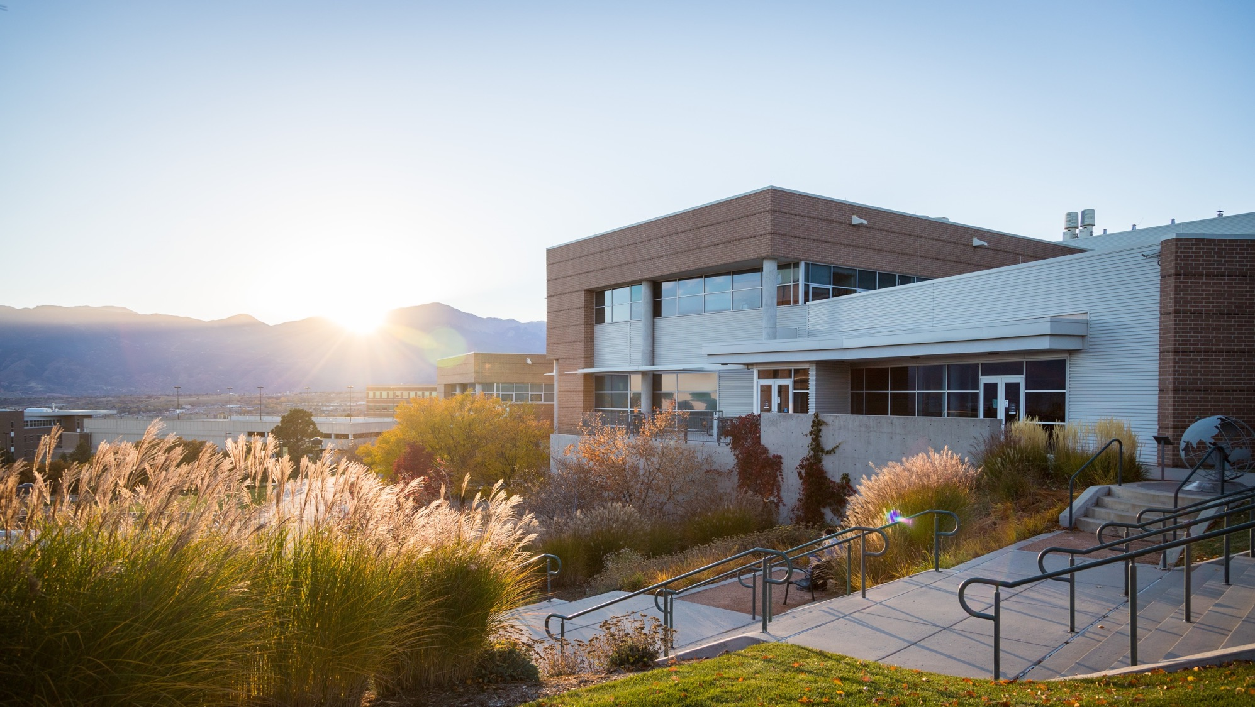
What other strategies do you use for building relationships with students?

Slide 17
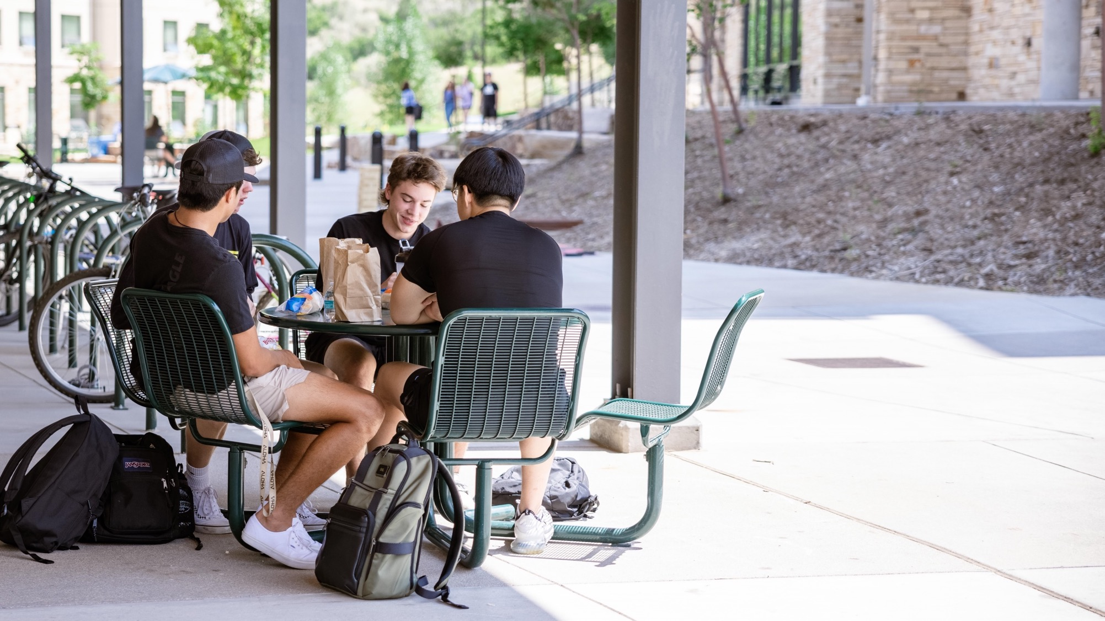
Connecting students to campus and each other
Outsource!
Paired discussion
Encourage study groups (Kuh et al., 2017)
Use Starfish

Slide 18
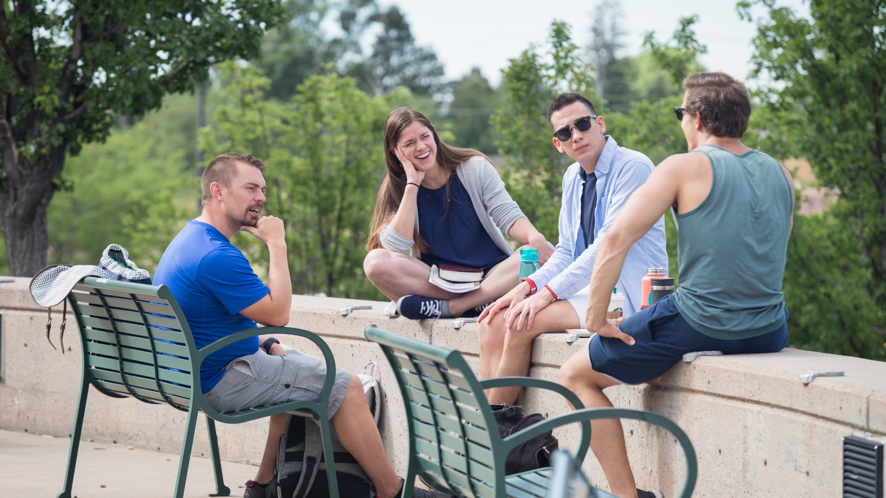
What strategies for connecting students to campus sound easy to implement?

Slide 19
Another teaching story!

Slide 20
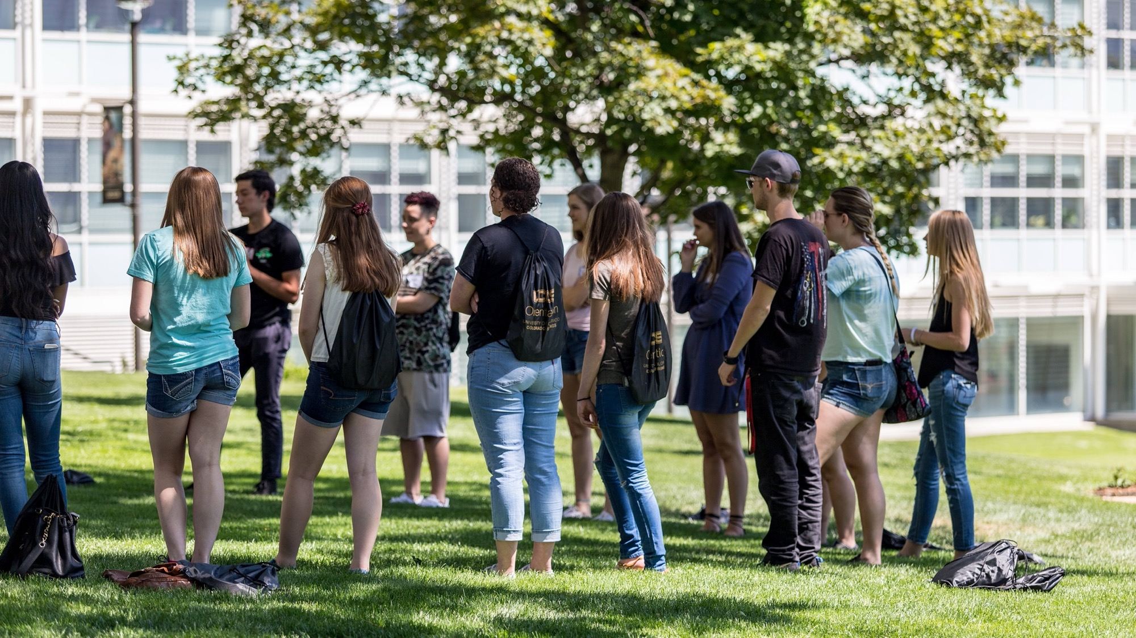
Require student involvement
One event for 20 minutes
Visit an Excel Center
Connect with a professor

Slide 21
At-risk students
What students are at risk in your discipline? In your teaching?

Slide 22
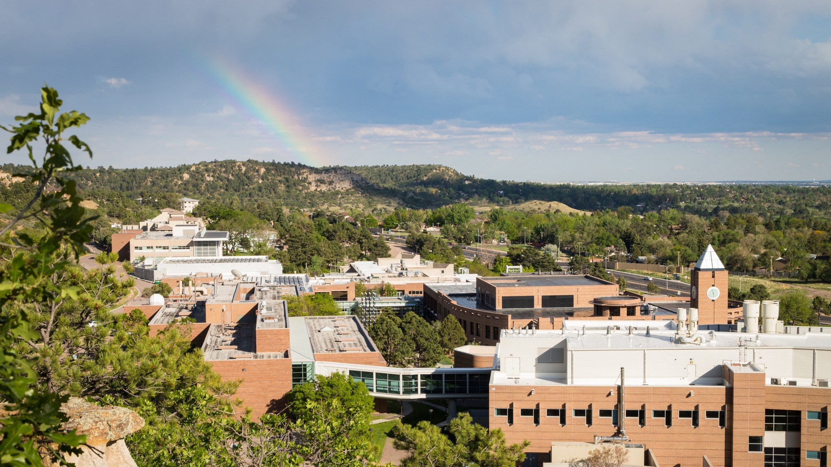
Thank you!
Ann Amicucci: aamicucc@uccs.edu

Slide 23
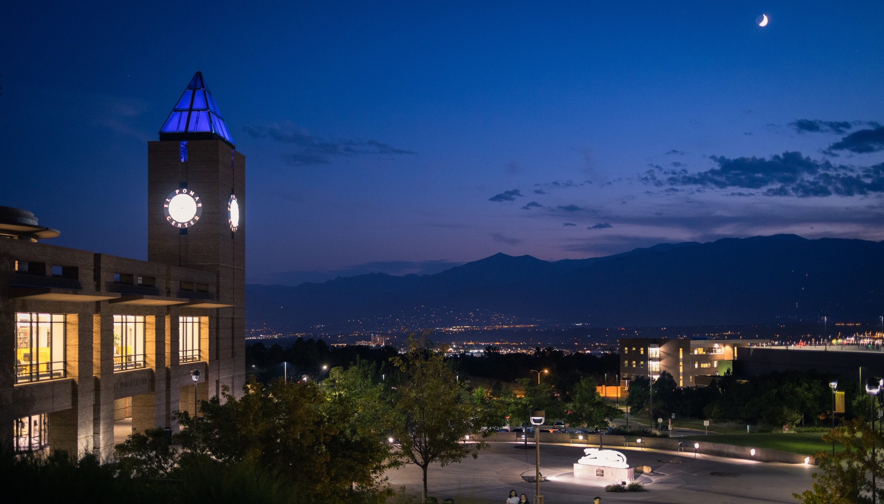
Photo credits:
UCCS campus and Pikes Peak: Jeffrey M Foster
Students in classroom: Allison Daniell Moix
Residence halls: Jeffrey M Foster
Tava Trail dirt trail: Allison Daniell Moix
Library clocktower: Savannah Waggoner
Pikes Peak through trees: Jeffrey M Foster
Two students on laptops: Chayce Lanphear
Janice Thorpe teaching: uncredited
Clyde mascot at table: Jeffrey M Foster
Military students: Emma Quinlyn
Library with flowers: Jeffrey M Foster
Students in classroom: Allison Daniell Moix
Student’s hands on laptop: Jeffrey M Foster
Student reading paper: Allison Daniell Moix
Biker in front of Main Hall: Jeffrey M Foster
Sunset behind campus building: Jeffrey M Foster
Students eating outside: Gabby Hensley
Student group outside: Jeffrey M Foster
Student in library: Allison Daniell Moix
Students standing outside: Savannah Waggoner
Student on laptop: Gabby Hensley
Rainbow over campus: Jeffrey M Foster
Library at night: Jeffrey M Foster
Evening silhouette of mountains: Savannah Waggoner
All courtesy of the University of Colorado Colorado Springs Photo Databases

Slide 24
References
Burke, A. (2019). Student retention models in higher education: A literature review. College and University, 94(2), 12-21.
EAB. (2019). Expanding well-being initiatives through faculty partnerships. Student affairs forum. [contact Ann for PDF]
Institutional Research. (2021). Fall 2020 first year cohort retention. University of Colorado Colorado Springs. https://ir.uccs.edu/sites/g/files/kjihxj1231/files/inline-files/Retention.2021.pdf
Koproske, C., Gfeller, H., Silverman, A., Hickman, C., & Ho, M. (2018). Defining the faculty role in student success. EAB. [contact Ann for PDF]
Kuh, G., O’Donnell, K., Schneider, C. G. (2017). HIPs at ten. Change: The Magazine of Higher Learning, 49(5), 8-16.
Lightner, J. (2017). Culturally inclusive teaching. Kent State University Center for Teaching and Learning. http://www.kent.edu/ctl/
Ryerson University Student Affairs. (2017). Cultivate your happiness: A ThriveRU weekly workbook. Facilitator’s resource manual. https://www.torontomu.ca/content/dam/thriveru/resources/ThriveRU-Facillitators-Web-08312017.pdf
Umbach, P., & Wawrzynski, M. (2005). Faculty do matter: The role of college faculty in Student learning and engagement. Research in Higher Education, 46(2), 153-184.
Venit, E., & Bevevino, D. (2020). The student success playbook. EAB. [contact Ann for PDF]

