Slide 2
Supporting Non-Native English Speakers in the Classroom
Grant Clayton
College of Education

Slide 3
A brief word about terms
Labels Matter
English as a Second Language (ESL)
English Language Learners (ELL)
English Learners (EL)
English as a New Language (ENL)
Culturally and Linguistically Diverse (CLD)

Slide 4
Typical Groups in Higher Education
Non-US citizen students (e.g. Saudi nationals in graduate programs)
Often studied international English
Levels of written and oral fluency reflect the school systems of their home country
US citizens/residents with various levels of K12 experience
Usually more comfortable with US English
Oral fluency is usually higher than written

Slide 5
Affective Filter

Slide 6
Acquiring a New Language
Oral comprehension
Oral fluency
Written comprehension
Written fluency
Academic comprehension
Academic fluency

Slide 7
Don’t fall for nodding
Ask a comprehension question that requires a reply

Slide 8
In Your Classroom
Multiple goals
Oral fluency/comprehension
Written fluency/comprehension
Specific content knowledge and skills

Slide 9
Jargon, idioms, and abbreviations

Slide 10
Idioms
See eye to eye
Speak of the devil
Cost an arm and a leg
Let the cat out of the bag
Feel under the weather
Kill two birds with one stone
Bite the bullet
Last straw
Elephant in the room

Slide 11
Let’s synergize an out of the box solution that leverages best practices for the IRB

Slide 12
Tips and Tricks
Many of these will likely help native speakers as well
Some may feel like a massive case of “duh”

Slide 13
Vocabulary
Build lists and publish in advance

Slide 14
Notes
PowerPoint in advance

Slide 15
Practice Wait Time
10 seconds

Slide 16
Other Questioning Strategies
Give them the question in writing a few minutes before and say “I’m going to call on you to answer this in 10 minutes”

Slide 17
Make use of video

Slide 18
Exemplars and Rubrics
Don’t expect students know what you want in terms of quality or format
Helps to support the Writing Center
How much does use/abuse of English matter to grading

Slide 19
Revise and Resubmit?

Slide 20
Lecture Pace
“I speak quickly and have a very heavy accent. You’ll have to pay attention”
Slow down
Pause
Ask questions that require a response
Beware of the rhetorical questions

Slide 21
Further Reading

Slide 22
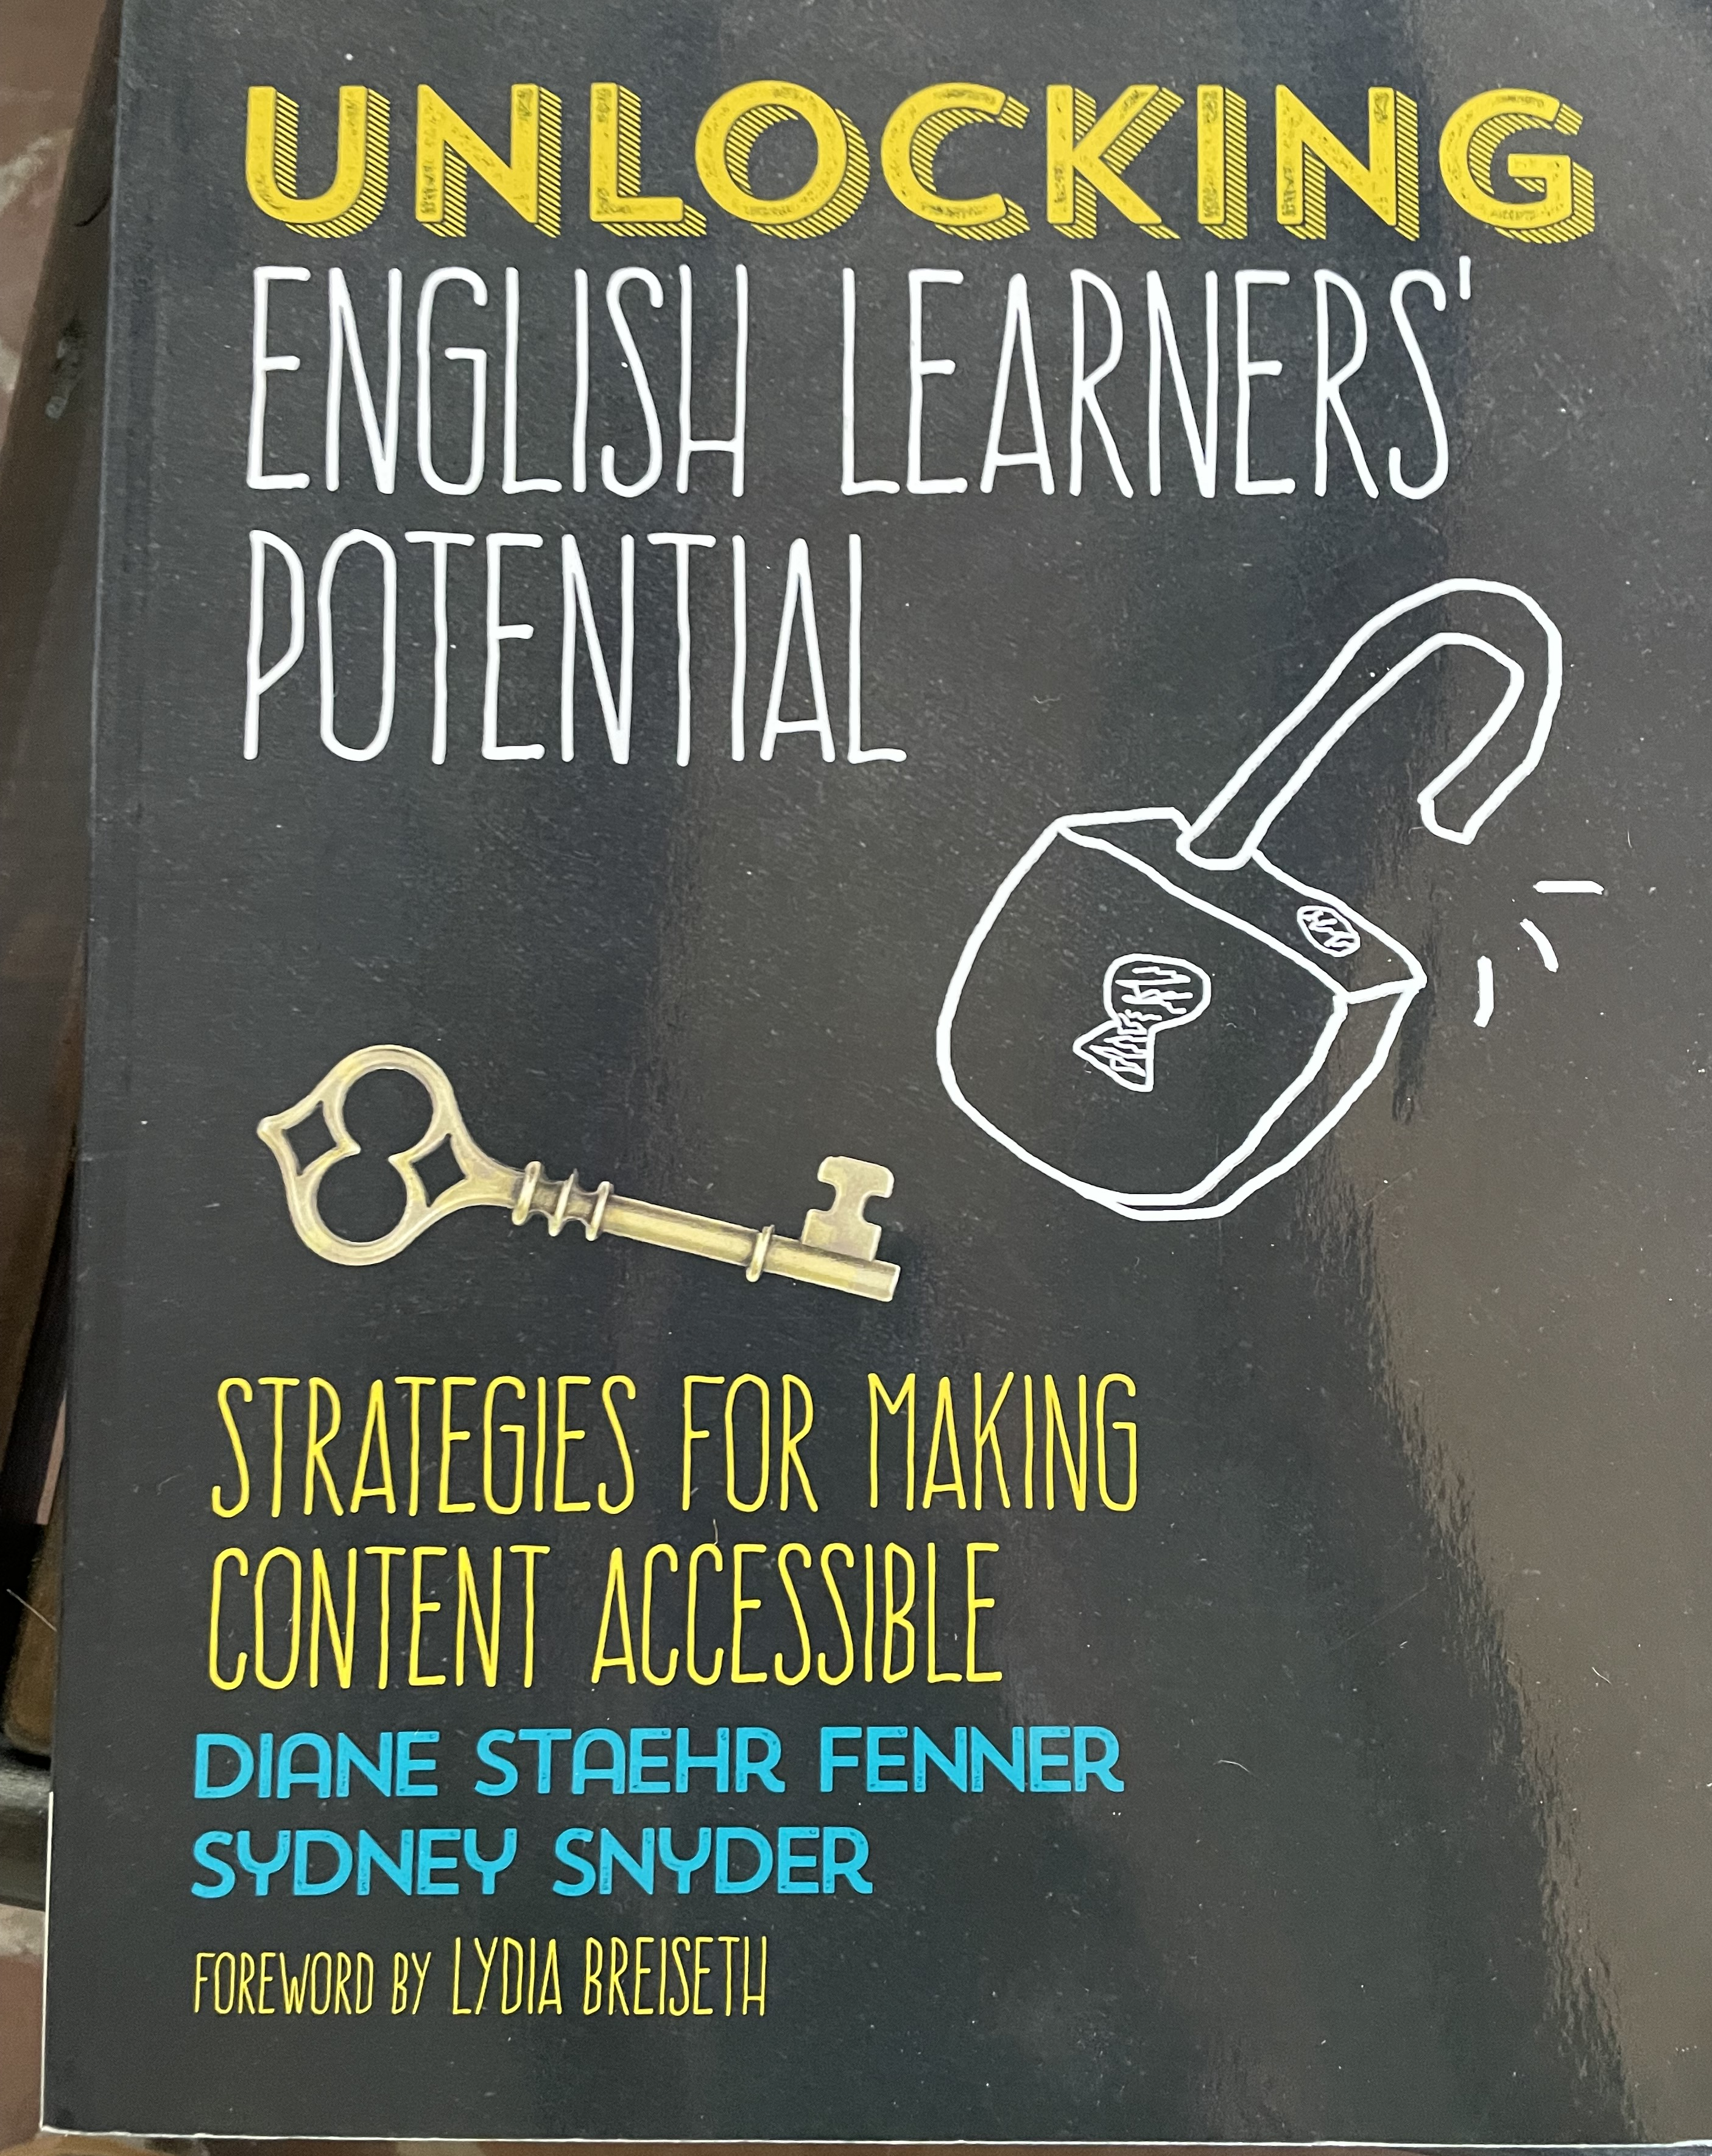

Slide 23
Case Studies and Questions

Slide 24
Call, Write Keep in Touch! How can I help you?
Grant Clayton gclayto2@uccs.edu

