Slide 1
Session 2: Collaborative Assignments and Projects
Please mute your audio and video while others are presenting or speaking.
High Impact Educational Practices in Teaching
12:15 – 1:30

Slide 2
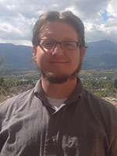
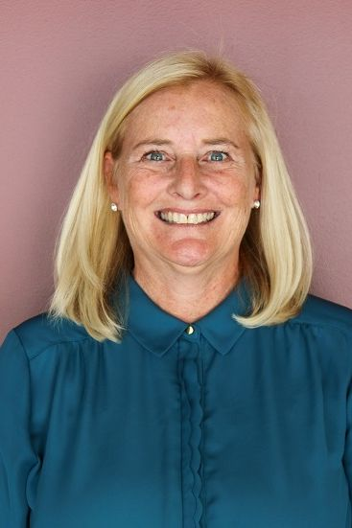
Meet Your Teaching Circle Facilitators
Phillip Haisley, M.A.
Senior Instructor / Director, Writing Portfolio Assessment
English
Tracy Gonzalez-Padron, Ph.D.
Director, Daniels Fund Ethics Initiative at UCCS & Professor of Marketing
Notes:
Angie

Slide 3
Session Agenda
Introductions
HIPS and Collaboration Overview
Collaborative Assignment Examples
Phillip's Environmental Advocacy Assignment
Tracy's Critical Thinking Application Assignment
Discussion and Questions

Slide 4
Introductions
Please tell us a little about yourself....
Name, Role, Department, Courses you Teach
Tell us about your experiences assigning collaborative work
Good or bad is fine!
What would you like to get out of today's Teaching Circle?

Slide 5
AAC&U’s High impact Practices (Kuh et al 2017)
First-Year Seminars and Experiences
Common Intellectual Experiences
Learning Communities
Writing and Inquiry Intensive Courses
Collaborative Assignments and Projects
Undergraduate Research
Diversity/Study Away/Global Learning
Service Learning, Community-Based Learning
Internships and Field Experiences
Capstone Courses and Projects
ePortfolio

Slide 6
AAC&U’s High impact Practices (Kuh et al 2017)
First-Year Seminars and Experiences
Common Intellectual Experiences
Learning Communities
Writing and Inquiry Intensive Courses
Collaborative Assignments and Projects
Undergraduate Research
Diversity/Study Away/Global Learning
Service Learning, Community-Based Learning
Internships and Field Experiences
Capstone Courses and Projects
ePortfolio

Slide 7
“NSSE” National Survey of Student Engagement
Higher-Order Learning
Reflecting and Integrative Learning
Learning Strategies
Collaborative Learning
Discussions with Diverse Others
Student-Faculty Interactions
Quality of Interactions
Supportive Environment

Slide 8
“NSSE” National Survey of Student Engagement
Higher-Order Learning
Reflecting and Integrative Learning
Learning Strategies
Collaborative Learning
Discussions with Diverse Others
Student-Faculty Interactions
Quality of Interactions
Supportive Environment

Slide 9
HIPS and Collaboration
Select Research
Students who persist to the second year engage in more collaborative learning - Griffin (2016).
Increased collaborative learning predicted increased retention - Loes et al. (2017).
"Social engagement” predicted retention at the student level – Shinde (2010).
“Supportive campus environment” predicted retention and graduation at the institutional level - Pike (2013).
Notes:
Angie

Slide 10
Regression Analysis NSSE on Rate of First-Year Retention

Slide 11
Regression Analysis NSSE on Rate of Six-Year Graduation

Slide 12
HIPS and Collaboration
General Recommendations
Students need support and instruction in HOW to collaborate
Guided "Project Planning" Activities
Presentations and Advice
Frequent Check-Ins with Faculty
Students need TIME to collaborate
Integrate it into the curriculum (don't put it "on top" of everything else)
Try a "flipped" classroom to create room for in-class collaboration
Require milestone submissions along the way
Notes:
Angie

Slide 13
HIPS and Collaboration
General Recommendations
Students value Authenticity
Base group projects around meaningful challenges and issues
Consider a "simulation" activity that mirrors real-world experience
Explicitly frame collaboration as a difficult but valued skill
Students value Accountability
Create methods for holding individuals accountable separately
Find other methods to encourage quality beyond grading
Consider the use of group or individual "contracts"
Allow students to provide input about their own contributions and the contributions of their group members
Notes:
Angie

Slide 14
Assignment Example
Phillip's Environmental Advocacy Project
Very "open ended" - Students shape the project
Create a real-world document that advocates for Sustainability
Asks students to identify a "Simulated" Context
Examples:
Grant Proposal
Empirical Research Proposal
Article in a Trade Magazine
Notes:
Angie

Slide 15
Assignment Example
Phillip's Environmental Advocacy Project
Phillip presents the "boundaries" for the project
Students brainstorm ideas and form groups in class
Students prepare a "Project Proposal" in class
Phillip reviews and returns with a "Group Contract"
Students complete a "Group Planning Document" in class
Students collaborate in and out of class
Students meet with Phillip for a check-in
Students submit along with a self-evaluation and group evaluation
Students present their project to the class and invited guests
Students receive individual grades based on project quality and contribution
Notes:
Angie

Slide 16
Assignment Example
Phillip's Environmental Advocacy Project
Phillip presents the "boundaries" for the project
Students brainstorm ideas and form groups in class
Students prepare a "Project Proposal" in class
Phillip reviews and returns with a "Group Contract"
Students complete a "Group Planning Document" in class
Students collaborate in and out of class
Students meet with Phillip for a check-in
Students submit along with a self-evaluation and group evaluation
Students present their project to the class and invited guests
Students receive individual grades based on project quality and contribution
Notes:
Angie

Slide 17
Assignment Example
Phillip's Environmental Advocacy Project:
Project Proposal
Groups propose their projects to me, including:
Topic and Purpose of Document
Intended Audience
Genre and Medium
I respond with a contract which includes:
Changes to their Proposal to meet Course Outcomes
Clear and Measurable Expectations
Resources or Examples to Model
Notes:
Angie

Slide 18
Assignment Example
Phillip's Environmental Advocacy Project:
Planning Document
Identify Roles and Duties
Leader, Secretary, Editor, Etc
Conceptualize the Project and Deliverables
Writerly Decisions
Info Needed
Outlines
Planning Your Work
Swapping Contact Info
Choosing Platforms and Mediums
Identifying Concrete Steps
Creating a Timeline
Notes:
Angie

Slide 19
Assignment Example
Phillip's Environmental Advocacy Project:
Personal Assessment
Because each group member gets scored separately, it is up to you to defend and justify the grade you receive. Below, I’ve listed some of the topics you should cover in the letter:
Which sections of the document did you write?
What was your assigned role in the project and what tasks did you do in that role?
What other tasks did you carry out for the group?
What important ideas did you present to the group?
What was your collaboration like with other group members?
Were you timely in meeting deadlines and responding to communication?
Notes:
Angie

Slide 20
Assignment Example
Phillip's Environmental Advocacy Project:
Peer Assessment
To create a sense of accountability, I would like you to assess each of your teammates on their performance in the project. Only you and I will see these assessments, but I will use it to determine their grade for the project. Please identify each group member by name and complete the following table to assess them. Type the name of your group member above the table, then assign them a score between 10 and 0 on each category. TEN IS HIGH; ZERO IS LOW. If you have additional comments about the performance of any of your group members, please type them in the space below.
How much did this group member contribute to the group's success?
How high was the quality of work this teammate produced?
How responsible was this teammate in responding to communication, attending meetings, meeting deadlines, etc?
How would you rate this teammate's contribution to the project overall?
Notes:
Angie

Slide 21
Assignment Example
Tracy's Group Application Assignments
Teaching Statement
A desire to supply the tools students need to succeed in their chosen career or personal life.
Strive to establish a connection between the course material and the student, stressing application tailored to the level of the student’s interests and understanding.
Notes:
Angie

Slide 22
Assignment Example: Group Application Assignments
Set up for student success
Canvas Home Page & Getting started module
Access class MS-TEAM
Course Help Information and Modules
Getting Started with Canvas
Library Research Instruction
Explore Writing Resources to communicate with clarity
Recognize plagiarism and practice citing sources
Microsoft Teams Resources
Group Work and Class Discussion Guidelines
Teamwork Component: Students will work in various small groups for discussions and assignments in this class. You should assume certain conditions about team performance and consideration.
Respect fellow class members time constraints.
Maintain confidentiality.
Practice active Listening.
Contribute ideas.
Respond constructively to the opinions of fellow class members..
Be a good classmate.
Language counts.
Notes:
Angie

Slide 23
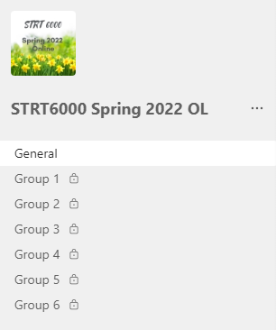
Assignment Example: Group Application Assignments
Set up for student success
Clear Assignment Descriptions
Syllabus – overview of assignments & course schedule
Canvas – assignments
Purpose
Align with learning objectives
Prerequisites
Detailed instructions
Rubric
Class MS-Teams Channel
Create and use private channels
Notes:
Angie

Slide 24
Assignment Example: Group Application Assignments
Online Class Syllabus
Group assignments to apply course concepts are an important part of the course.
Each assignment requires sharing and doing so a smaller group is both more manageable and more engaging, as the members can ask “better” questions and delve more deeply into solving problems with fewer people.
Group Application assignments require interaction throughout the week – plan accordingly!
Group application assignments use the meeting and collaboration features of Microsoft Teams. Each small group will have a private channel in the course TEAMS group.
On Canvas, one person from the group should submit one document to the assignment – grade will be same for all in the group, unless an individual did not participate in the group work.
Notes:
Angie

Slide 25
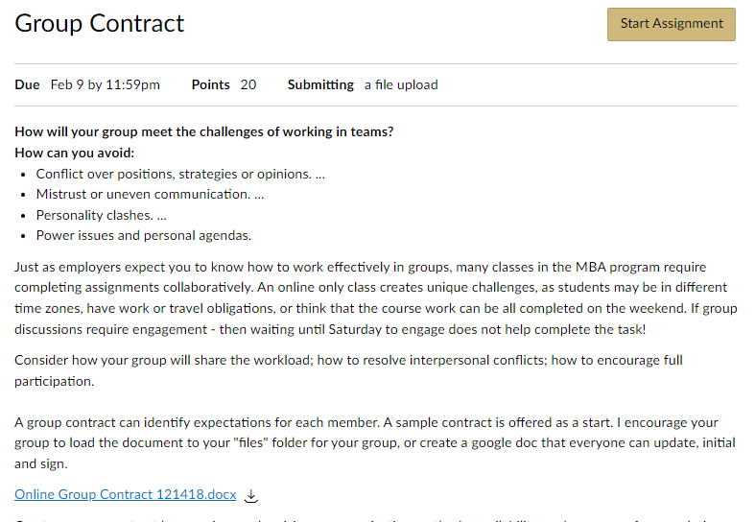
Assignment Example: Group Application Assignments
Group Contract (20 pts):
Consider how your group will share the workload; how to resolve interpersonal conflicts; how to encourage full participation. A group contract can inform expectations for each member. A sample contract supplies a starting point, you may use as a template and tailor to your group needs. Create a group contract by agreeing on the vision, communication methods, availability, and processes for completing projects. Each member needs to initial each item and then sign the document at the end. Submit one document for each group.
Notes:
Angie

Slide 26
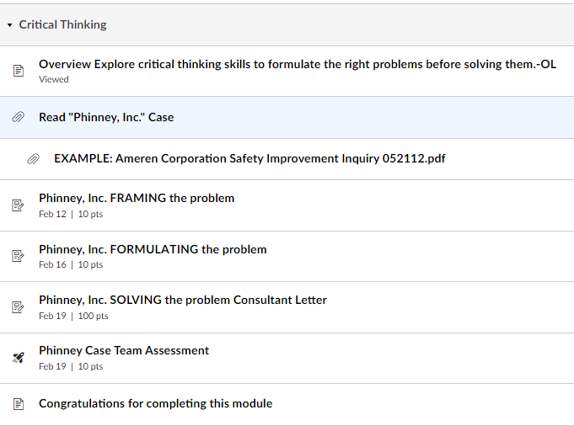
Assignment Example: Group Application Assignments
Phinney, Inc. Case | Critical Thinking Module (130 pts) (see course site for instructions)
As a group, you will be tasked to resolve a situation involving the use of location-based technology in a competitive industry. Use the Collaborate Structured Inquiry and techniques presented for case analysis using the process explained in the module. You may need to do added research to support the information presented in the case before creating recommendations. There are three group assignments, submit one document for each group. A group assessment is an individual grade.
Notes:
Angie

Slide 27
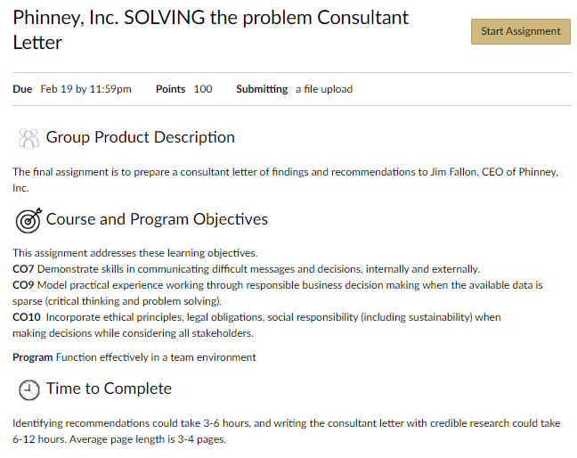
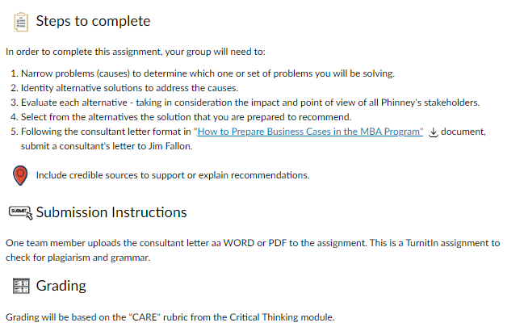
Assignment Example: Group Application Assignments
Notes:
Angie

Slide 28
Assignment Example: Group Application Assignments
Grading Rubric
Clear and Precise
Accurate and Logical
Relevant, Broad, Deep, and Significant
Evenhanded and Ethical
Notes:
Angie

Slide 29
Assignment Example: Group Application Assignments
Phinney Case Team Assessment
Instructions
Now that your group presented a recommendation for Phinney, Inc, consider how the group worked to identify and solve their problem.
Was everyone in your group able to contribute? Did you address the concerns of each stakeholder group? Did you solve the right problem? How did your group recommendation meet ethical principles: Was it honest and transparent? Would the actions build trust with company stakeholders? Did it meet the spirit of laws? Was it able to create value for all stakeholders?
Complete this survey individually on how your team handled the Phinney situation.
Notes:
Angie

Slide 30
Assignment Example: Group Application Assignments
Phinney Case Team Assessment
Communication: How did the team communicate and share information? Were there challenges in communication? How were challenges addressed?
Assessment of issue: Was the process for issue assessment purposeful? Were stakeholder management tools or critical thinking tools used to guide the discussion? Were you broad in identifying issues?
Focus: Was the team able to maintain focus on the key issues? Were discussions and inputs relevant to the reason the team is working on the task at hand?
Teamwork: How well did YOU (Other team members)exhibit the following teamwork characteristics?
Contributes to Team - Helps the team move forward by offering ideas or solutions and analyzing those of others.
.Individual Contributions - Completes all assigned tasks by deadline; work accomplished is comprehensive and advances the project.
Encourages Engagement - Constructively building upon or incorporating the contributions of others and invites others to participate and engage.
Fosters Constructive Team Climate - Supports a constructive team climate by doing the following:
Treats team members with respect, Has a positive attitude about the team and its work. Motivates teammates Provides assistance and/or encouragement to team members
Responds to Conflict (if any) - Addresses conflict directly and constructively, helping to manage/resolve it in a way that strengthens the team.
Notes:
Angie

Slide 31
Discussion and Questions
Questions?

