Slide 1



Got OER?
Implementing Open Educational Resources
Notes:
Susan
Welcome to the Implementing Open Educational Resources session. Just a few housekeeping items before we get started, just a reminder that if you can take some notes on page 9 in your interactive notebook. For those joining us online, check the chat for the link to the digital notebook if you haven’t already been utilizing it. We also want to provide you an opportunity for a little interaction so have your browsers open for some OER searching.

Slide 2

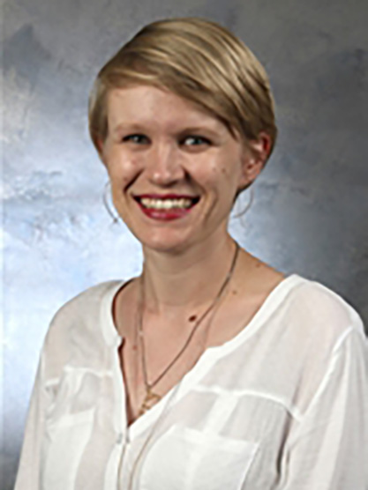
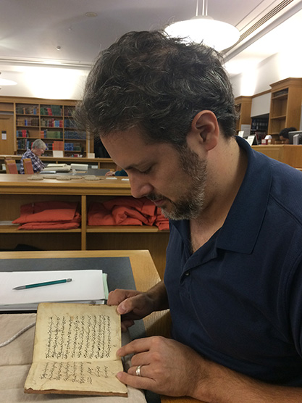
Session Presenters
Susan Vandagriff
Scholarly Communications Librarian & Assistant Professor
Katherine Cliff
Senior Instructor Mathematics, LAS
Patrick D’Silva, Ph.D.
Instructor
Philosophy, LAS
Notes:
Susan will introduce each presenter☺
Katherine is the current UCCS OER Champion and is sharing a bit about the open etext and online homework system for her math courses.
Patrick D’Silva has focused his OER efforts on guiding students as OER creators and will be sharing a bit about how he fostered that process in his Introduction to Philosophy course.

Slide 3




What are OER?
case
studies
instructional
tools
courses
articles
Resources that are free to retain, reuse, revise, remix, and redistribute and are often identified by a Creative Commons License.
videos
music
Lesson
plans
graphics
images
learning activities
Notes:
Susan
How many of you have heard of open educational resources also know as OER?
How would you describe what OER are?
Click to show the definition and as you explain that OER are more than just a digital, open textbook, the different formats will populate on the slide.

Slide 4








Creative Commons Licenses
Attribution
Attribution-Share Alike
Attribution-NonCommercial
Attribution-NonCommercial-Share Alike
Attribution-NonCommercial-No Derivatives
Attribution-No Derivs
Public Domain Dedication
Notes:
Susan
As mentioned, the best way to identify OER is to look for a Creative Commons license. These generally appear at the bottom of documents or webpages.
The licenses indicate how others are able to use and attribute OER with the least restrictive being Public Domain and CC BY and the most restrictive being the CC BY NC ND. Explanation of use for a given license is generally linked to the Creative Commons website so you are able to determine how you can use the OER.

Slide 5







Why OER?
Reduce
Fill
Provide
Vary
Keep
Offer
Heighten
textbook cost.
gaps in curriculum.
alternative sources of information.
ideas and perspectives about subject matter.
content current.
easier access to content.
student engagement.
Notes:
Susan will transition to Katherine who will focus on the overall reasons for using OER with specific emphasis on her own rationale and what it led to.
Knowing what OER are and how to identify and use greatly contributes to implementing them successfully and focusing on the reason for OER use also helps guide in the implementation process.
NOTE: Each box is animated to fly in from the bottom (feel free to adjust them as needed)
Katherine, please focus on the reasons that specifically influenced your OER creation.

Slide 6

One OER journey
Why?
  No textbook is perfect, so the opportunity to pull from multiple sources and add a bit of my own content was appealing.
  Math textbooks are expensive!
  Math homework systems are expensive and often clunky!
precalcandtrig.net
  Free
  Interactive
  Built-in practice with instant feedback
Open-source online math homework: myopenmath.com
  Completely free for instructors and students
  Closes the feedback loop
  Highly customizable
Click to see book
Notes:
Katherine please transition back to Susan who will share about how to locate and search for OER.

Slide 7
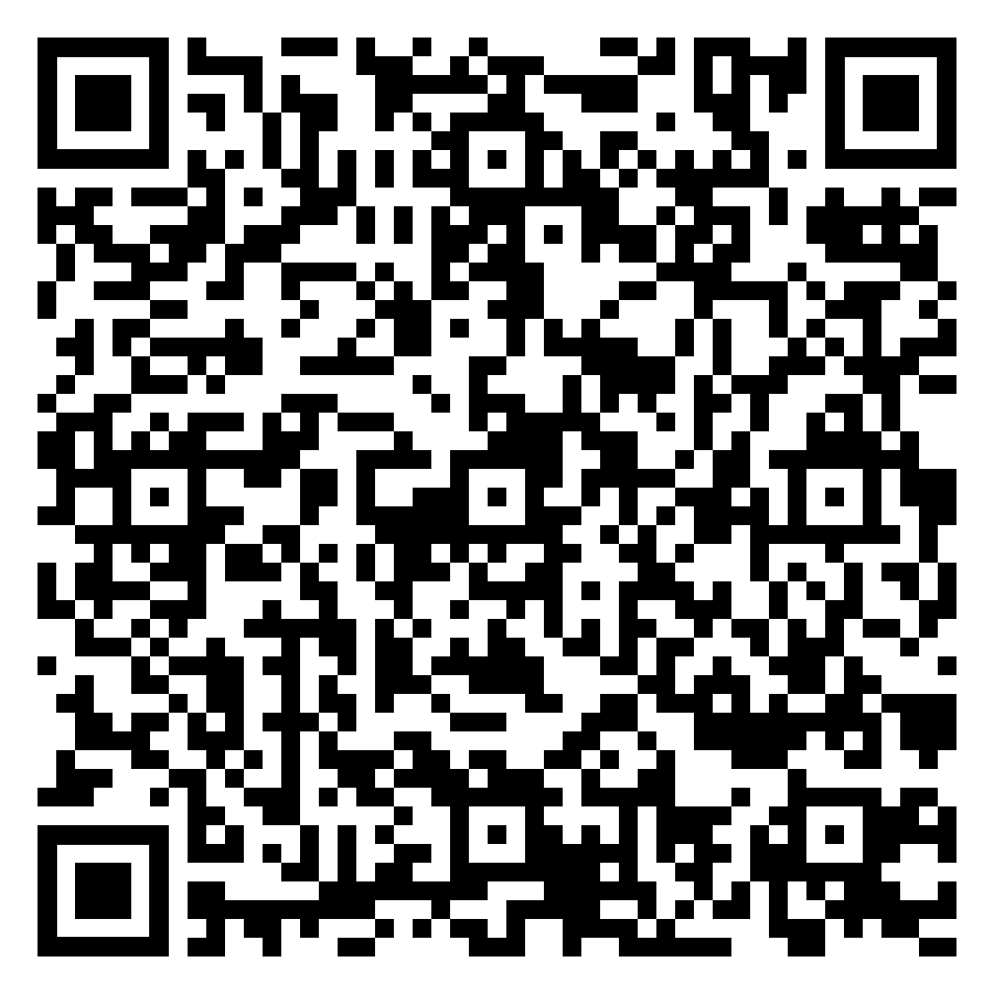
Where can OER be found?
Open Educational Resources: Find LibGuide​
Resource Guide for Locating OER
Notes:
Susan will guide participants through the OER libguides and share tips for searching and show how OER can be found on Google, YouTube, Merlot.
Emphasis should also be on how to use the Resource Guide to search for OER by format.
The link to the Resource Guide should be shared in the Zoom chat as well: Resource Guide for Search for Higher Ed OER_2021.pdf

Slide 8



Conduct an OER Search
Determine a type of OER to locate.
Access the Resource Guide for Locating OER or the UCCS OER LibGuide.
Utilize any Advanced Search options or filters to refine the search.
Notes:
Susan, please direct participants to utilize the LibGuide or Resource Guide to conduct a mini search for OER based on their own subject matter.
Link to Resource Guide: Resource Guide for Search for Higher Ed OER_2021.pdf
Ask if anyone will share what they found.

Slide 9





Educate Students about OER
Raise student awareness of OER.
Initiate student utilization of OER.
Establish ways for students to contribute to OER.
Provide opportunities for students to create OER.
Encourage student advocacy of OER.
Notes:
Susan, please transition to Patrick who will share about educating students about OER.
A key to OER implementation is educating students about how it is utilized in your course. Patrick is going to share how that can be done and the strategies he has used in his own course.
NOTE: This slide is set to bring in one point at a time, please customize as desired.
Patrick, please share each of this points emphasizing how each
Raise awareness: introduce in syllabus, offer the OER pre- and post-course surveys
Initiate utilization: OER as course content
Establish ways for students to contribute: edit, add to, include OER as a part of projects
Students a OER creators: major assignments or projects where students create OER
Students as OER advocates: Use student testimonies about their OER successes, encourage students to speak at OER related events, to inquire about its use in other classes,

Slide 10

Student OER Creations
Rationale: Empowering students through active learning
Pilot project in PHIL 1000
  Students identified particularly challenging readings and designed "a guide that would have been useful for their past selves"
  Students are often very new to reading primary sources, and philosophical texts are particularly challenging
    Writing style
    Historical context
    Application to present day
  Provide an overview of the student OER creation process in your course.
  Show examples of some of the best and varied products.
Notes:
Patrick after your part, please transition back to Susan who will share about the OER SUCCESS Program and provide next steps for participants.

Slide 11
Student OER Creations
Examples
  Provide an overview of the student OER creation process in your course.
  Is Mind Material?
  Successful Note-taking Strategies
Notes:
Patrick after your part, please transition back to Susan who will share about the OER SUCCESS Program and provide next steps for participants.

Slide 12



OER SUCCESS Program
OER SUCCESS Part 1 – Pathway to OER Success
OER Course Inventory
Expedition OER
Course Curriculum Analysis
OER Integration Plan
OER SUCCESS Part 2 – Pillars of OER Success
Expanded OER Use
OER and Students
OER SUCCESS Part 3 – Destination Success
Vision
Publication
Sharing
Notes:
Susan, please provide an overview of the OER SUCCESS Program
The FRC in conjunction with the Open CU initiative, offers an OER SUCCESS Program to guide you in the implementation of OER. The Program is composed of three courses that helps you carve out a specific path for OER SUCCESS. Program participation is supported through the Colorado Department of Higher Education OER grants where stipends may be earned for searching, implementing, and curating/creating OER.
Part 1 – More in-depth look at OER, how to find, ways to plug it into your course, and plan for implementation.
Part 2 – Dives into how to expand the use of OER for enhancing student engagement, interactions, and inclusiveness.
Part 3 – Guides in the curation and creation of OER.

Slide 13




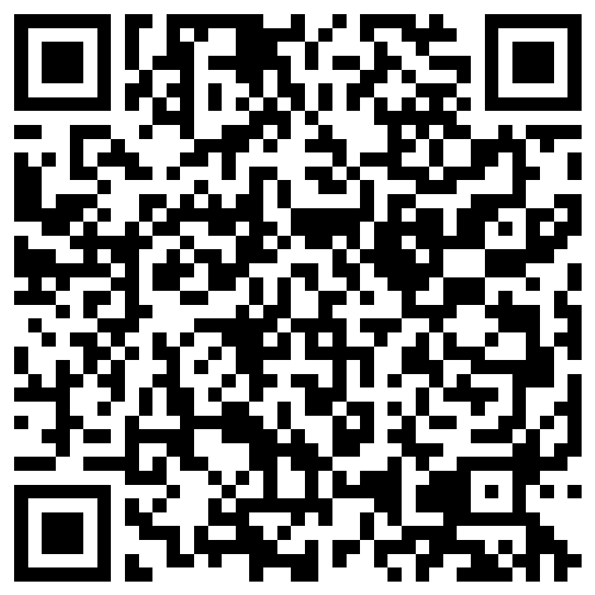
Next Steps
Susan Vandagriff svandagr@uccs.edu
OER librarian
Angie Dodson adodson2@uccs.edu
OER instructional designer
Choose OER that works for your instructional style, course content, and student needs.
Complete the
Next Steps in My OER Journey Survey
Notes:
Susan, please conclude the session by encouraging participants in the next steps.
NOTE: Participants will need to use their UCCS credentials to access the form.

